Slide 1
Car Insurance Claim Prediction
INSURANCE CLAIM PROBABILITY BASED ON POLICY FEATURES AND SAFETY RATINGS
by
Manda Nitin Reddy
ADV Data Science and AI

Slide 2
Problem Statement
Insurance companies struggle with accurately predicting the likelihood of claims on car insurance policies, as claim frequency and severity are influenced by a wide range of factors.
Inaccurate claim predictions can lead to suboptimal premium pricing, financial losses, and inefficient claim management.
Predicting future claimants and analyzing the factors influencing claims can significantly enhance the company's ability to assess risk, set accurate premiums, and improve overall financial performance and customer satisfaction.
2

Slide 3
Objective
The objective is to develop a robust predictive model capable of determining the likelihood of an insurance claim being made. Additionally, the goal is to identify and analyze the critical factors that influence claim frequency, providing valuable insights for risk assessment and decision-making in insurance underwriting and claims management.
Data Overview
Feature Engineering
Best Feature Analysis
Exploratory Data Analysis (EDA)
Model Training and Evaluation
3

Slide 4
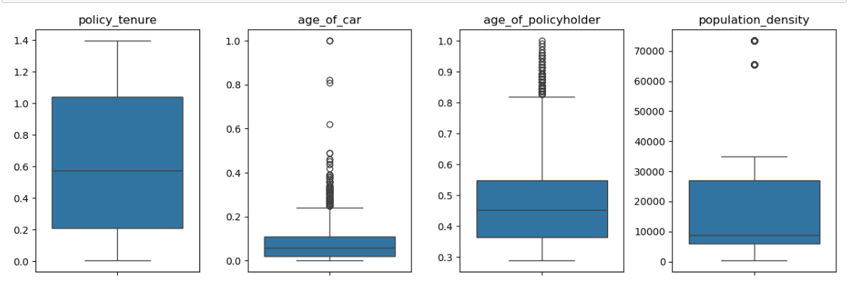
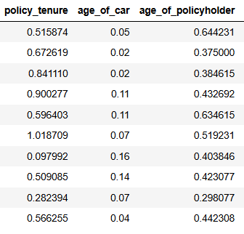
Data Overview
Total | 44 columns | 58,592 rows
Null values found - 0
Duplicated Records - 0
No invalid or inconsistency in categorical columns
Target variable – ‘is_claim’
Column type | No. of columns | Total Rows
int | 4 | 58592
float | 12
object | 28
Key Observations:
The numerical features such as the age of the car, age of the policyholder, and policy tenure are transformed and do not represent their literal values, making direct interpretation of these numbers potentially misleading.
Several numerical columns exhibit categorical behavior, as they contain a limited number of unique values.
Outliers have been detected in continuous columns age_of_car, age_of_policyholder, population_density.
4

Slide 5
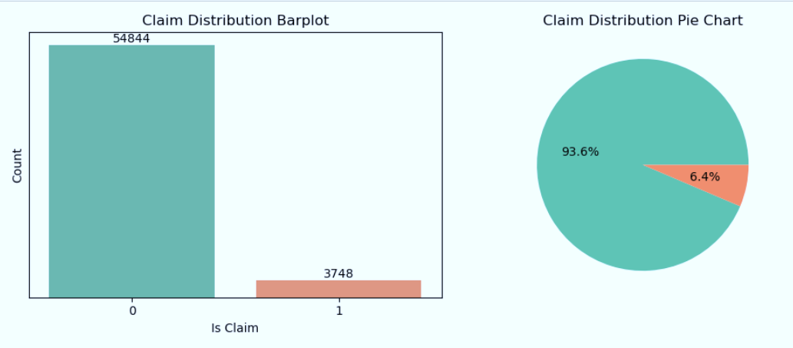
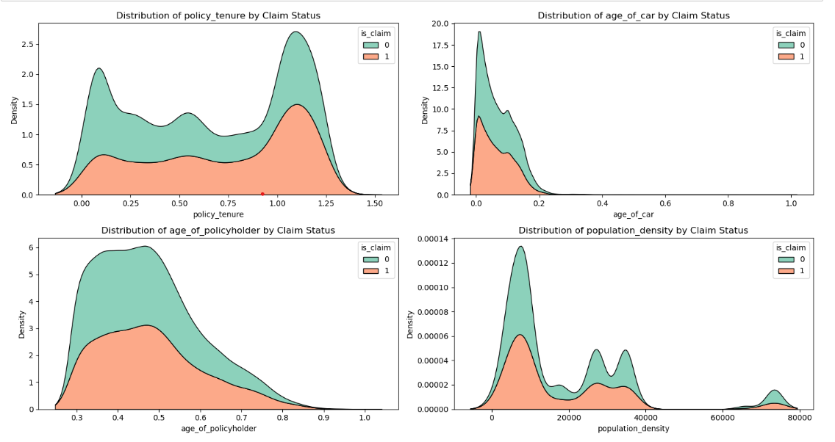
Exploratory Data Analysis (EDA)
1. Analysis on target and Continuous Features
Key Observations:
The target variable is_claim shows a significant class imbalance, with around 94% of the instances belonging to class 0 (no claim) and only 6% to class 1 (claim).
Policy Tenure & Age of Car: Claims tend to increase in the later stages of the policy (last 4-6 months), and are more frequent for newer cars, indicating a higher risk associated with younger vehicles.
Age of Policyholder & Population Density: Younger to middle-aged policyholders file more claims, while claims are surprisingly higher in less densely populated areas, contrary to expectations of more claims in densely populated regions.

Slide 6
2. Analysis on Categorical Features
Given the large number of categorical columns (39), the analysis has been split into three groups for better clarity:
Categorical Columns with Numerical Expressions
Columns with More Than 3 Unique Values
Yes/No Type Columns
Though numerous categorical variables exist, each with different categories, the differences in claim rates across these categories are generally minimal. However, a few observations stand out with notable variations:
make
displacement
model
area_cluster
esc
power_steering
These features show a slightly higher claim rates within the categories
6

Slide 7
Feature Engineering
Removing unnecessary columns
Handling Outliers
Converting datatypes and new column creation
Train Test split
Train set – 80% Test set – 20%
Encoding categorical features
Label Encoding
Feature selection
multicollinearity tests
Mutual Information
Handling Class Imbalance
SMOTE
RandomUnderSampler
7

Slide 8
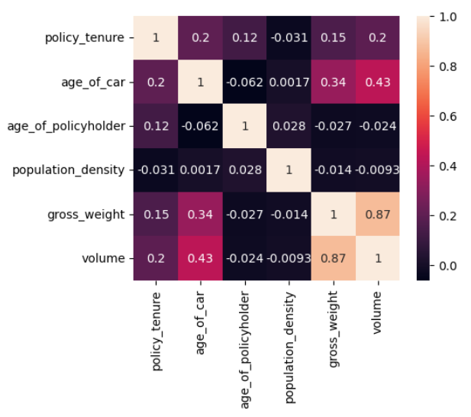
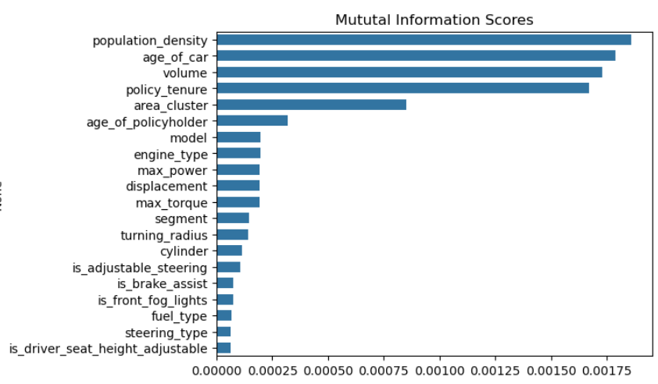
Feature Selection
Multi-Collinearity
(Features that give redundant information)
Mutual Information Scores
(Gives us a value on how much the a feature has information about the target column)
Best Features
population_density
age_of_car
volume
policy_tenure
area_cluster
age_of_polic_holder
model
engine_type
max_power
displacement
max_torque
segment.

Slide 9
Model Training
Tree-based models like Decision Tree, Random Forest, Gradient Boosting, and XGBoost were chosen due to their flexibility and minimal data assumptions.
The models were evaluated using Accuracy, Recall, Precision, F1 Score, and ROC_AUC to measure performance comprehensively.
Both SMOTE and RandomUnderSampler techniques were used to address class imbalance and determine model performance on different sampling sets.
GridSearchCV was applied for hyperparameter tuning, testing various parameter combinations to optimize model performance.
Base Model Training
(Decision Tree, RandomForest, GradientBoosting, XGBoost)
Model Evaluation
(Accuracy, Recall, Precision, F1 score, ROC_AUC)
SMOTE resampled
train set
Undersampled majority class
train set
Hyperparameter Tuning
(GridSearchCV)
Best Model Selection
(Model that can best identify the class 1 label)
9

Slide 10
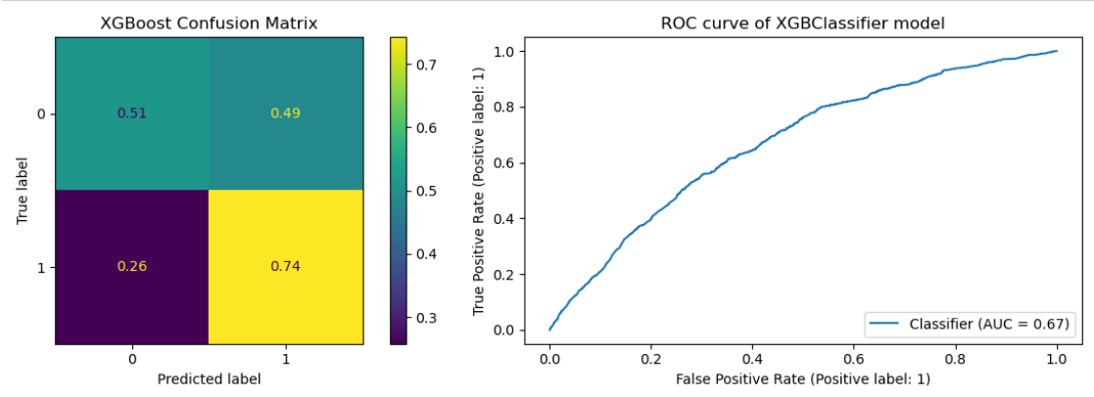
Best Model
The XGBoost model, after hyperparameter tuning, achieved the best performance with a recall of 74%, making it highly effective for identifying claimants, which is the primary business objective.
When comparing SMOTE and Random Undersampling, the models trained on the undersampled dataset performed better in terms of recall, though at the cost of accuracy. The models trained on the SMOTE dataset showed high accuracy but struggled with low recall and other key metrics like F1 score and precision.
While accuracy and metrics like F1 score, precision, and ROC_AUC remained relatively low, the model’s ability to prioritize recall aligns with the business needs for detecting claims. The XGBoost model showed an AUC of 0.67, indicating a moderate ability to distinguish between claimants and non-claimants.
The best model is XGBoost Classifier under RandomUnderSampler, with the following hyperparameters:
n_estimators = 405
max_depth = 5
learning_rate = 0.037
gamma = 4.96
With the best recall score of 0.74, the model successfully identifies 74% of the true claimants (true positives), which is crucial for the business objective of identifying potential claimants.

Slide 11
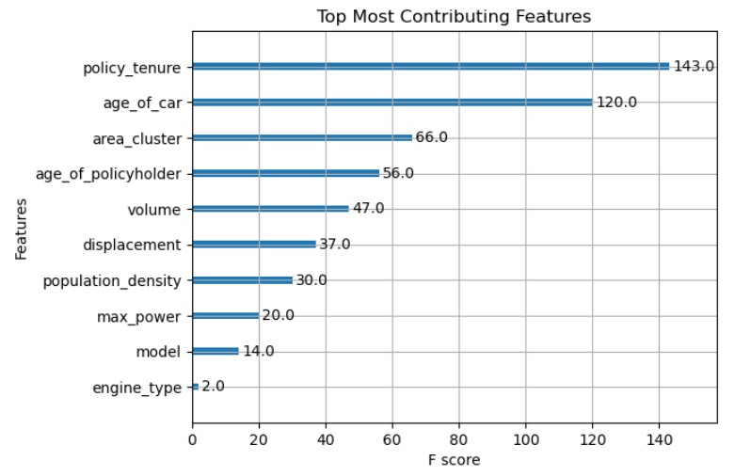
Features that contributed to model prediction
policy_tenure
age_of_car
area_cluster
age_of_policy_holder
These features played a significant role in identifying patterns and trends in claim frequency, highlighting their importance in assessing risk and determining premiums for car insurance policies.

Slide 12
Conclusion:
Key Factors
The primary factors influencing the model's predictions were policy_tenure, age_of_car, area_cluster, and age_of_policy_holder, which played a crucial role in assessing claim probability. These features significantly contribute to understanding risk and determining premiums.
Best Model
After extensive experimentation, XGBoost Classifier with RandomUnderSampler was selected as the best-performing model, achieving a recall of 74%. Although the model showed a moderate AUC of 0.67, it successfully identified claimants, aligning with the business objectives.
Data and Future Improvements:
Due to the non-raw format of several key features, further analysis is limited. Having access to raw data would allow for deeper insights and improved feature recognition. Additionally, more comprehensive data could enhance model performance and help better understand these key features, ultimately improving accuracy and overall prediction quality.

Slide 13
Thank you
Manda Nitin Reddy
mandanitinreddy@gmail.com

